Slide 1
System Development (COMP 1713)
An Introduction to the Course
Part 1: Housekeeping – What, How, Who… for students on the Greenwich Maritime campus
Dr. Simon Scola
Notes:
S.E.1
A.M.Fedorec

Slide 2
Introduction
1. Housekeeping of the course
  Who?
  Lecturers and Tutors
  When and Where?
  Timetable
  How?
  Lectures, Labs, Tutorials, DUL, Assessment
Notes:
S.E.1
A.M.Fedorec

Slide 3
Introduction Cont’d
2. Introduction to the course
  Why?
  The issues of System building
  What?
  Course context and content
Notes:
S.E.1
A.M.Fedorec

Slide 4
Who? - Lecturers
Co-ordinator: Dr. Simon Scola
Room: QM364
Email: s.scola@greenwich.ac.uk
Lecturers:
  Dr. Simon Scola
Tutors:
  Simon Scola, Yasmine Arafa, Ralph Barthel, Christine Du Toit, Mohammed Hassouna, Mahtab Hossain, Chaoying Ma, Fotios Spyridonis, Tony Valsamidis, Andy Wicks
Notes:
S.E.1
A.M.Fedorec

Slide 5
When and Where - Lectures?
One each week – two hours
Two instances – attend one according to which tutor group you are in
https://cms1.gre.ac.uk/teachmat1516/rts.asp?banner=COMP1713
REGULARY CHECK YOUR TIMETABLE
THE ROOMS AND TIMES ARE OPEN TO CHANGE
 Fire Exits 
Notes:
S.E.1
A.M.Fedorec

Slide 6
Intellectual Discipline
Theory
  Concerned with formal definitions, axioms, theorems and proofs
Application/design
  Assess requirements, formulate specifications, prepare, implement, test and evaluate design
Methodology/models/abstraction/semiotics
  Form hypotheses, construct models, make predictions, run experiments and test design
Ethical / professional framework
Notes:
S.E.1
A.M.Fedorec

Slide 7
SD - How?
Formative Education
  How you learn
Summative Education
  How you are assessed
Notes:
S.E.1
A.M.Fedorec

Slide 8
How? Higher Education
Not Training
“A miracle as new as the first crocus but its earth was the leaf drift of centuries”
Endows people with:
  Creative and moral capacity
  Thinking skills
  Depth of Knowledge
Transmit an ethos
Provides discipline and language to address problems
“A Vulgar Mechanick can practise what he has been taught or seen done, but if he is in error he knows not how to find it out and correct it, ...; Whereas he that is able to reason nimbly and judiciously ... is never at rest till he gets over the rub”
Isaac Newton
Helen Wadell
David Blunket, Greenwich, 2000
Notes:
S.E.1
A.M.Fedorec

Slide 9
Metacognitive Miscalibration
“Thinking about thinking”
One of the most important but least understood impediments to learning.
Typical manifestations:
  “Can you create a Web-enabled time and services billing application?”
  “Sure, no problem”
Also manifests in the classroom:
  “I think there must be some kind of mistake with my mark.
  I know I did well and yet I only got 14%”
  “I don’t see why they make us do this stuff we already know it!”
Smith,D.K., Moores, T., Chang, J., Prepare Your Mind for Learning, CACM V48(9):115-118
Notes:
Programming 1 - Java
A.M.Fedorec

Slide 10
“A great number of people think they are thinking when they are merely rearranging their prejudices.”
  William James
Notes:
Programming 1 - Java
A.M.Fedorec

Slide 11
Five Orders of Ignorance
0OI Absence of ignorance,
knowledge is present and demonstrable
1OI Lack of knowledge but recognise the fact so can remedy the situation
2OI Unrecognised absence of knowledge.
Do not know what it is you do not know,
cf. missing or misunderstood requirements
3OI Absence of a process for recognising ignorance.
4OI meta-ignorance: ignorance of the orders of ignorance
Higher education aims to remedy 2OI & 1OI
(n.b. most sophomore (“wise-fool”) students are 2OI)
Armour, P.G., The Five Orders of Ignorance, CACM, V43(1), Oct 2000, pp.17-20
Notes:
Programming 1 - Java
A.M.Fedorec

Slide 12
SD - How?
Formative Education
  Lectures (every week)
  Tutorials and discussion (many)
  Directed Unsupervised Learning
  Personal reading and study
  Coursework (two parts)
    A series of online quiz
    A written work to be uploaded
Notes:
S.E.1
A.M.Fedorec

Slide 13
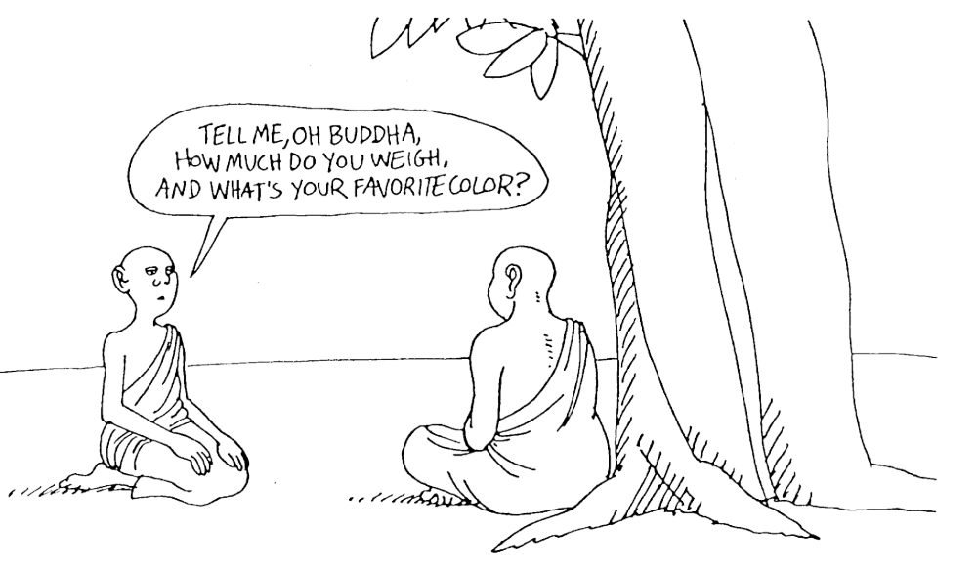
Lectures
Feel free to:
be courteous and professional, (e.g. punctual, attentive...)
discuss or comment (e.g. bring in your personal insight/experience)
ask questions (n.b. the value of the answer will be dependant on the quality of the question
Notes:
S.E.1
A.M.Fedorec

Slide 14
Lectures Cont’d
Attend lectures!!!
Large lectures are VERY different to FE college
Be early
Concentrate and take notes even if you have handouts
Do not let the person next to you distract you.
If your neighbour starts talking to you or distracting you politely tell them you will chat to them afterwards.
Do not talk or distract your colleagues.
Save it for afterwards.
SD101.<number>

Slide 15
How – Tutorials
Tutorials
  In a classroom with a tutor
  1 Hour (every week)
Notes:
S.E.1
A.M.Fedorec

Slide 16
Coursework
Is formative as well as summative
  When you do not understand something read it up.
  The online quiz cover knowledge / comprehension
  Its not just summative; use the results to improve
Notes:
S.E.1
A.M.Fedorec

Slide 17
Summative Assessment
100% coursework,
Notes:
S.E.1
A.M.Fedorec

Slide 18
DUL: Reading and Personal Study
Continuous (even if not directed)
Note for every hour you spend in classes or labs you should spend at least one hour in unsupervised learning (e.g. in the library)
Indicative Reading:
  Ian Sommerville, Software Engineering, 9e, Addison-Wesley, 2011
Roger S. Pressman. Software Engineering A Practitioner's Approach , 7e, McGraw Hill. 2009
Britton C., & Doake, J., Software System Development - A gentle introduction (4th ed.), McGraw Hill, 2006
Stevens, P., Pooley, R., Using UML - Software Engineering with Objects and Components (2nd ed.), Addison Wesley 2006
“A man ought to read just as inclination leads him;
for what he reads as a task will do him little good.”
Samuel Johnson
Notes:
S.E.1
A.M.Fedorec

Slide 19
More resources
Notes/ tutorial sheets on web
CMS intranet (teachmat), Moodle and the University portal
Library and on-line journals collection
Other support – programming and maths surgeries, English support classes
Check Study Skills Support on the portal

Slide 20
A side note on use of English
As a degree student you will be writing essays, reports, system documentation, exam answers and much, much more.
Even on a computing degree, good written English is essential.
The University provides English for academic purposes support tutorials – check the portal
Note all formal communications (e.g. emails to your tutor) must be proof read before sending. Do not be chatty and matey: “hi mr alex wot tuta grup i am in?”. Many people will automatically delete emails when the sender clearly could not be bothered to take care over what they were writing.
SD101.<number>

Slide 21
How? - Summative Assessment
2 assessments:
One written upload,
Four multipart quiz (fortnightly)
    40% - written upload
    60% - online quiz
Notes:
S.E.1
A.M.Fedorec

Slide 22
Notes on Assessment
Start work early
Do not leave to the last minute
Do not copy other peoples work – plagiarism is a serious academic offence and you will lose your chance for a degree
SD101.<number>

Slide 23
How? – Summative
What is being assessed?
Evaluation
Synthesis
Analysis
Application
Comprehension
Knowledge
Bloom, Taxonomy of Educational Objectives, in Software Engineering Institute’s
Report on Undergraduate Software Engineering Education, 1990
Notes:
S.E.1
A.M.Fedorec

Slide 24
Remember
  Lectures, Tutorials, DUL
Attend all (in mind as well as body). On Time!
  Course-work
Do all exercises and course-work. In Time!
Finally this is your degree:
  University is not like school.
  No one can do it for you.
  You must put in the work.
Notes:
S.E.1
A.M.Fedorec

Slide 25
Summary
Basic Housekeeping: Who, Where, When
Educational principles: How of the course
This is your degree if you want it you must put in the work.
Notes:
S.E.1
A.M.Fedorec

